Slide 1
Explicit Spotify Song Classification
David Chan

Slide 2
Purpose
Create a model to determine whether a song is explicit based off some features from Spotify’s API for future songs
Notes:
Not all explicit songs are listed as explicit when uploaded

Slide 3
Features
Used
Name
Artist(s)
Album
Energy
Valence
Tempo
Duration
Time Signature
Release Year
Explicit
Not Used
Album ID
Artist ID
Track Number
Disc Number
Key
Loudness
Mode
Speechiness
Acousticness
Instrumentalness
Liveness
Release date
Notes:
Energy is a measure from 0.0 to 1.0 and represents a perceptual measure of intensity and activity. Typically, energetic tracks feel fast, loud, and noisy. For example, death metal has high energy, while a Bach prelude scores low on the scale. Perceptual features contributing to this attribute include dynamic range, perceived loudness, timbre, onset rate, and general entropy.
Valence is a measure from 0.0 to 1.0 describing the musical positiveness conveyed by a track. Tracks with high valence sound more positive (e.g. happy, cheerful, euphoric), while tracks with low valence sound more negative (e.g. sad, depressed, angry).
Many of these (speechiness, acousticness, instrumentalness) are not used because they are determined by Spotify
Album ID for an album always the same.
Did not look at lyrics of songs because words can mean different things if said differently or depending on other words
I didn’t steal a cookie from the cookie jar I didn’t steal a cookie from the cookie jar
I haven’t listened to most of these songs so I won’t

Slide 4
Data Set Information
Songs from between 1908 to 2020
106162 albums
165365 artists or groups of artists
Approximately 7% of these songs are explicit
Notes:
Artists:
- Mariah Carey is different from Mariah Carey and Whitney Houston
Around 7 songs on average by artists

Slide 5
Train-Test Splits, Accuracy, and Area Under ROC
80-20
Accuracy : 96.77%
Test Area Under ROC: 98.31%
75-25
Accuracy : 96.75%
Test Area Under ROC: 98.28%
70-30
Accuracy : 96.74%
Test Area Under ROC: 98.22%
Notes:
#Model 1 80-20 split
#Accuracy : 0.9676762048130143
#Training Area Under ROC: 0.9992808974017898
#Test Area Under ROC 0.9831225938810771
#Model 2 75-25 split
#Accuracy : 0.9674617074378462
#Training Area Under ROC: 0.9993084178588645
#Test Area Under ROC 0.982823692357705
#Model 3 70-30 split
#Accuracy : 0.9673963863521301
#Training Area Under ROC: 0.9993391035377046
#Test Area Under ROC 0.9821757322179495

Slide 6
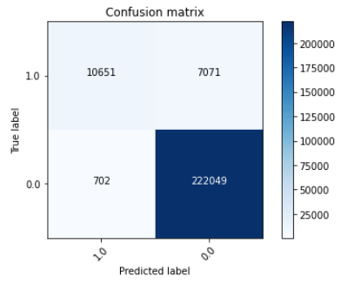
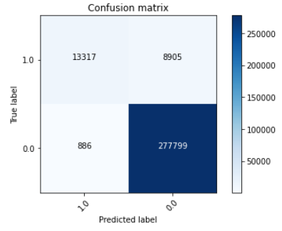
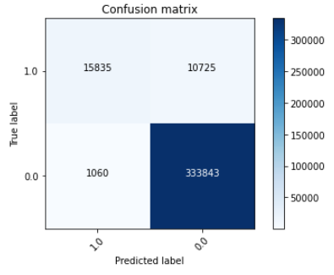
Results
Notes:
80-20
Accuracy : 0.9676762048130143
Precision: 0.9382
75-25
Accuracy: 0.9674617074378462
Precision: 0.9376
70-30a
Accuracy : 0.9673963863521301
Precision: 0.9372

Slide 7
Conclusion
Models “work”
Future experiment requirements
Data set
Features used
Notes:
Training set might not have had enough for determining whether a song was explicit or not.
Features limited to using only ones that are from music itself
- Not using energy, valence, etc. from Spotify

